Slide 1





NPN HACKATHON
BATCH-4

Slide 2
TEAM DETAILS
COGNIZANT MENTOR | Mr. NAGASUNDARAM
INTERNAL MENTOR | Mrs. HANNAH ROSE ESTHER
TEAM LEADER | PRABHAKAR V
TEAM MEMBER | DHANUSHIYA S M
TEAM MEMBER | JAGADEESH M
TEAM MEMBER | KANISHKA B
TEAM MEMBER | PRITHI PRASANNA P
TEAM MEMBER | SHREERAM T

Slide 3
PROBLEM STATEMENT
Customer Segmentation and Upselling Strategy: Our primary objective is to identify potential customers for upselling within a specific industry using customer care logs and datasets.
DATA SOURCE
https://www.kaggle.com/datasets/anshulmehtakaggl/cdrcall-details-record-predict-telco-churn

Slide 4
ABSTRACT
This Project is to do customer segmentation using clustering techniques and exploratory data analysis (EDA) on a customer care dataset. This analysis identified high-potential customers for upselling, guiding targeted marketing strategies. The framework can evolve into a recommendation system, optimizing personalized product suggestions and enhancing revenue through effective upsell strategies.

Slide 5
PROJECT WORKFLOW
Exploratory Data Analysis (EDA)
EDA includes visualizing data distributions, analyzing feature correlations, and identifying trends using scatter plots to understand key relationships in the data.
Clustering with K-Means
K-Means segments customers into clusters based on similarity, optimized using the Elbow Method, and visualized using PCA plots for clear identification of customer groups.
2
4
1
3
5
Defining the Objective
The project aims to analyze customer behavior using EDA and clustering to derive actionable insights for product upsell and improved decision-making through a Streamlit interface.
Feature Scaling and Dimensionality Reduction (PCA)
Data is normalized with StandardScaler, and PCA reduces dimensionality, capturing the most variance to visualize clusters effectively in a 2D space.
Using Streamlit for UI Interface
Streamlit provides an interactive interface where users can explore EDA and clustering results through a sidebar, displaying insights dynamically for easy stakeholder engagement.

Slide 6
OUR SOLUTION
Our solution is to perform EDA on the Provided Dataset and then group the customers based on similarities between them using K-means Clustering and suitable Dimensionality Reduction and then calculate the churn rate for each clusters and based on the churn rate we can target the customers for upsell.

Slide 7
MODULES
01 - Data Loading Module
02 - EDA (Exploratory Data Analysis)
03 – Dimensionality Reduction
04- Clustering Module
05 - Visualization Module

Slide 8
MODULE 01: DATA LOADING
Purpose: Facilitates the loading of datasets required for both Exploratory Data Analysis (EDA) and Clustering tasks.
load_data(file_path): A utility function that reads a CSV file from a specified path and returns a Pandas DataFrame, ensuring that the data is in a format suitable for subsequent analysis.

Slide 9
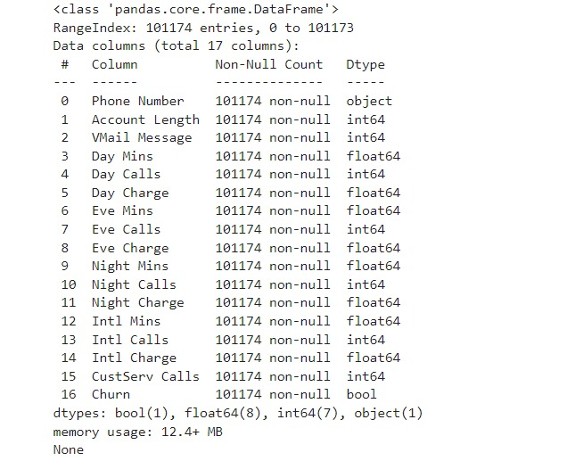
DATA SOURCE DESCRIPTION
The dataset contains 101,174 records across 17 columns, with no null values. It includes a mix of data types: Boolean, Float, Integer, and Object. The data covers customer account details, call duration, charges, and churn status, with all columns fully populated.

Slide 10
MODULE 02 : EXPLORATORY DATA ANALYSIS (EDA)
Purpose: Provides an overview and preliminary analysis of the dataset, enabling users to understand the data structure and initial characteristics before proceeding to more complex analyses.
Core Idea:
1.Dataset metadata display (e.g., shape, column names).
2.Data preview, including the first few rows, to give users an immediate sense of the dataset’s content.
3. Assumptions clarification, such as inferred units of measurement, which guide the interpretation of the data.

Slide 11
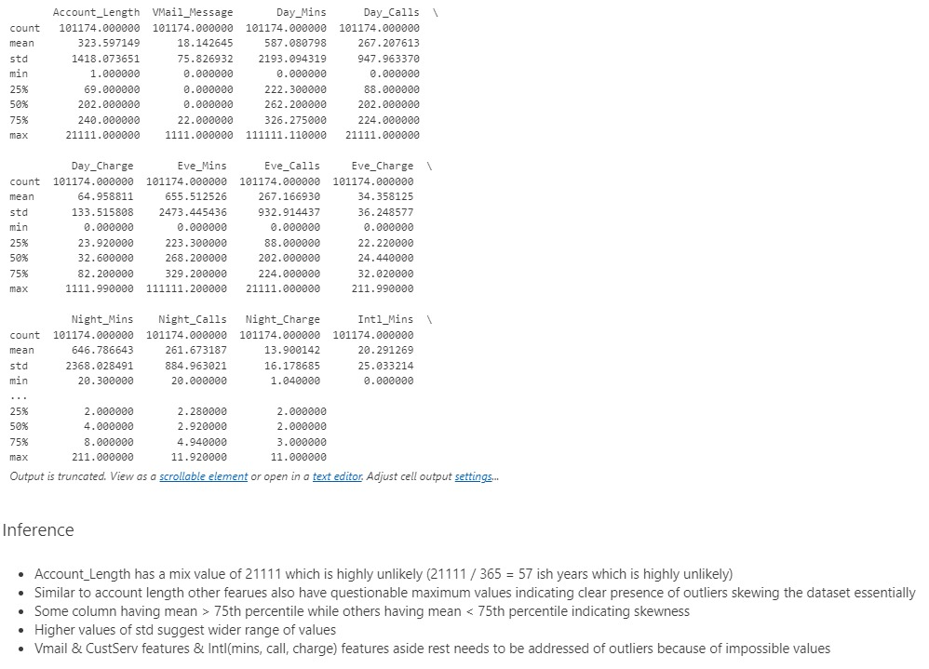

Slide 12
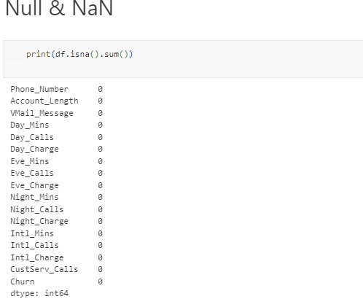

Slide 13
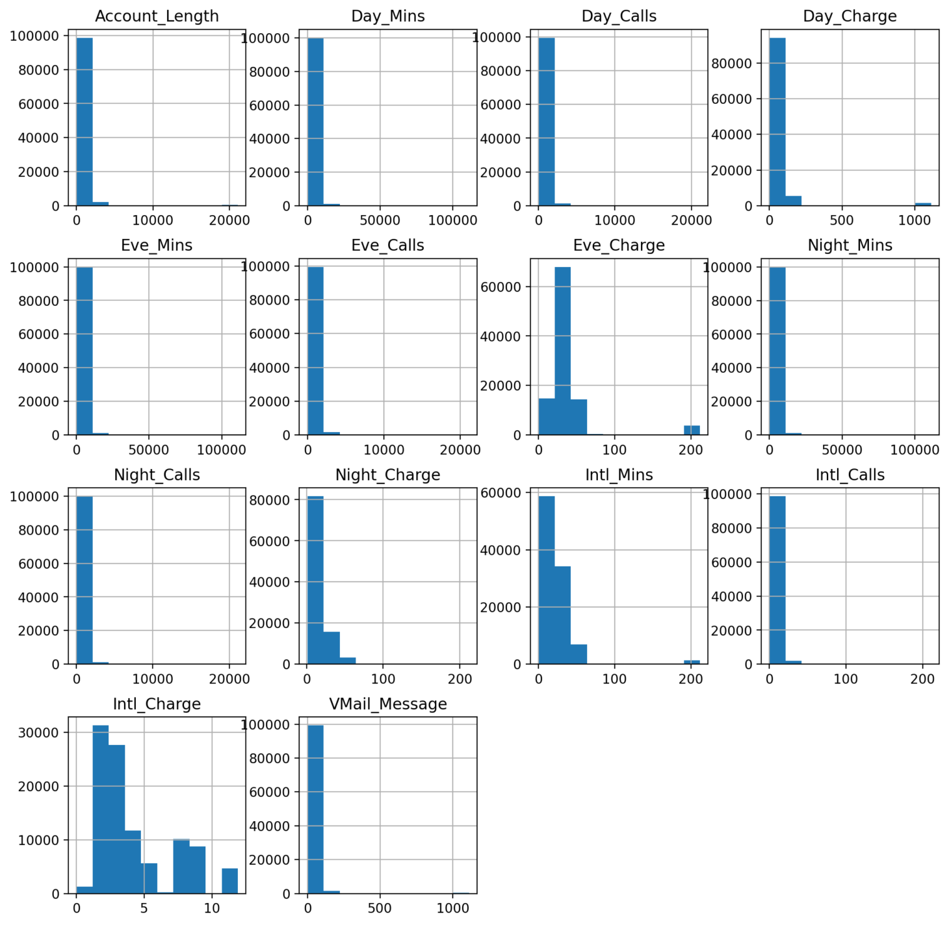
HISTOGRAM BEFORE REMOVING THE OUTLIERS

Slide 14
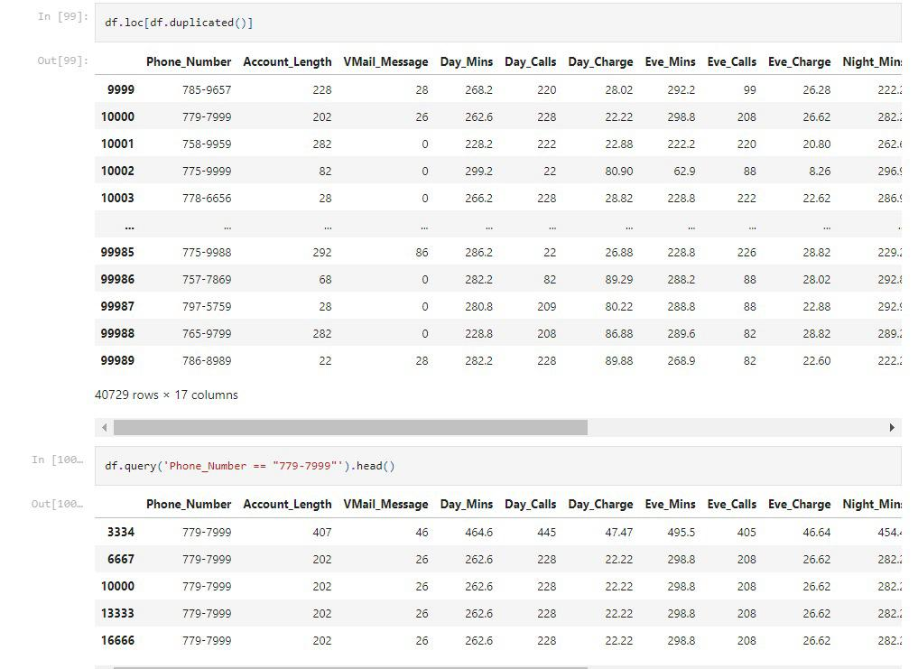
REMOVING DUPLICATES

Slide 15
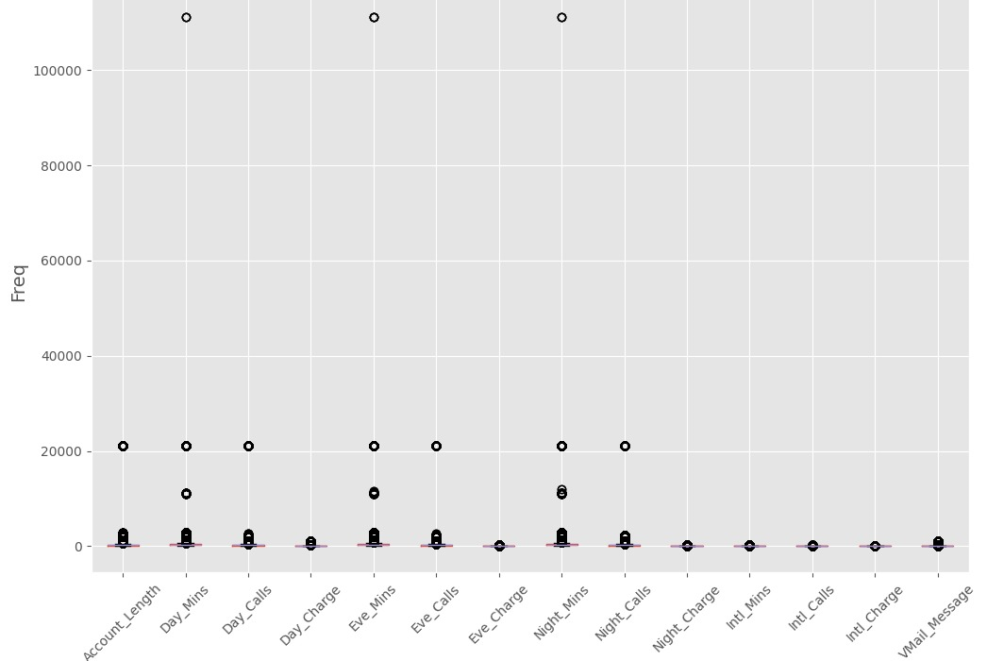
BOXPLOT BEFORE REMOVING THE OUTLIERS

Slide 16
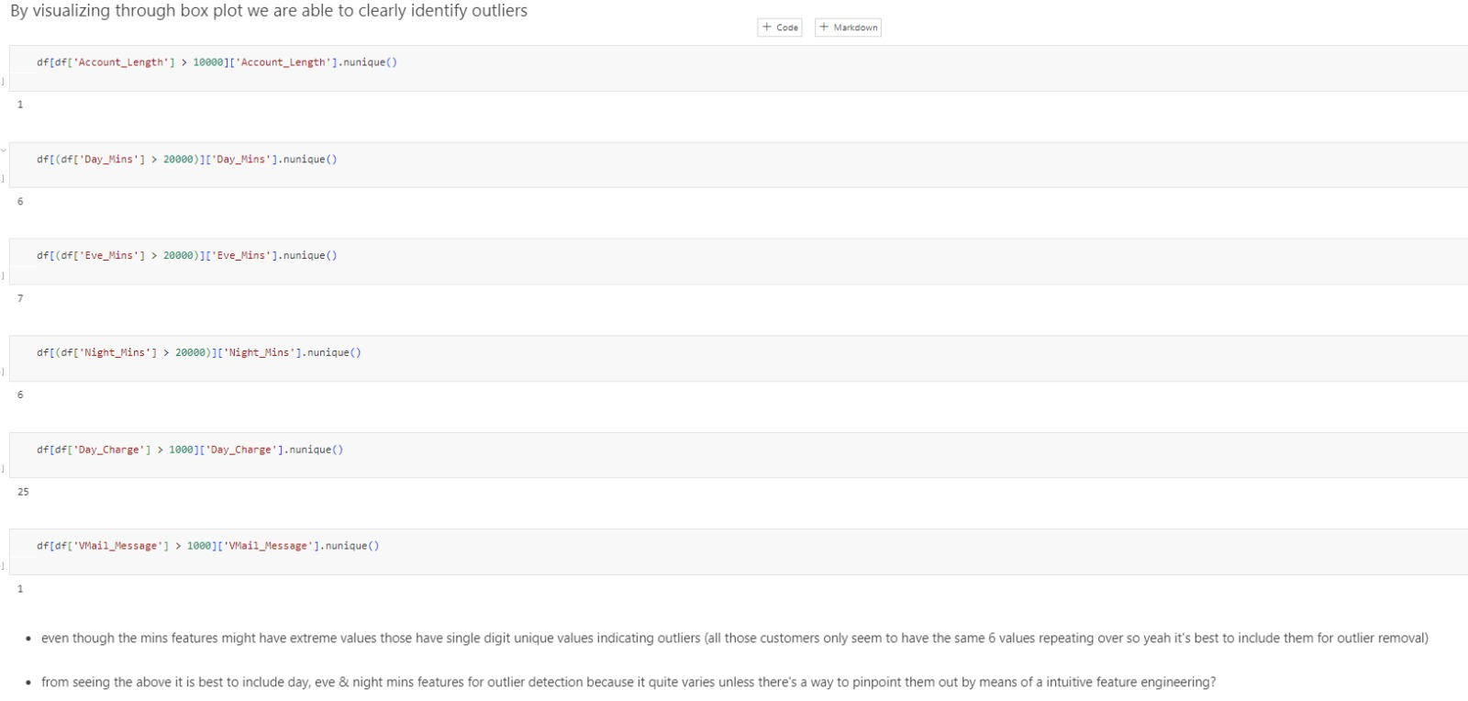

Slide 17
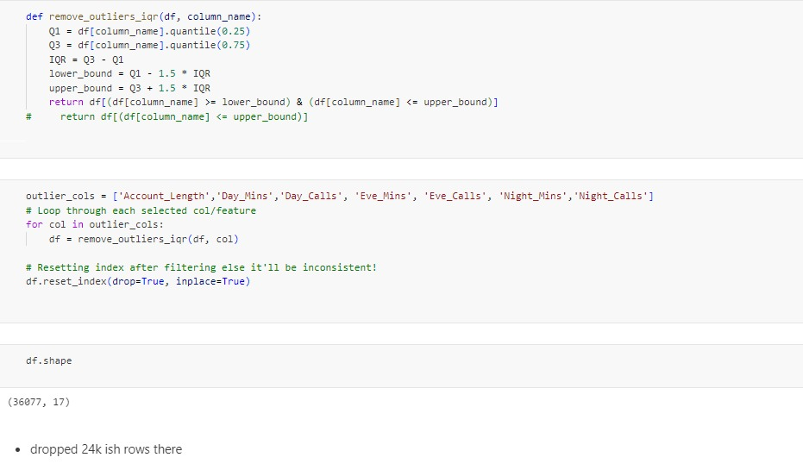

Slide 18
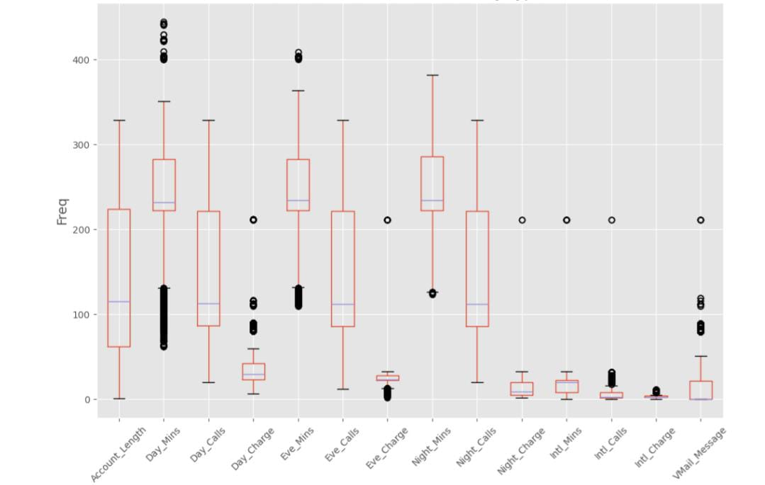
BOXPLOT AFTER REMOVING THE OUTLIERS

Slide 19
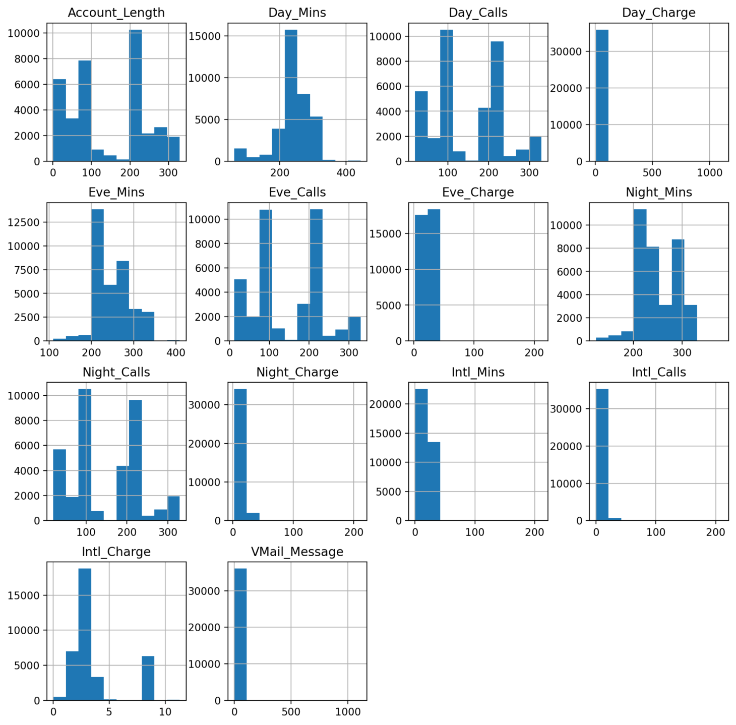
HISTOGRAM AFTER REMOVING THE OUTLIERS

Slide 20
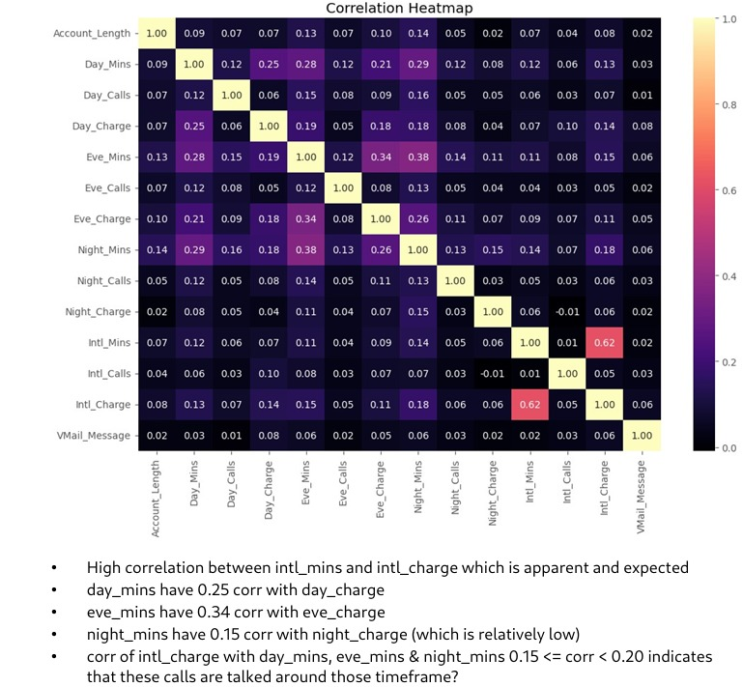
CORRELATION HEATMAP

Slide 21
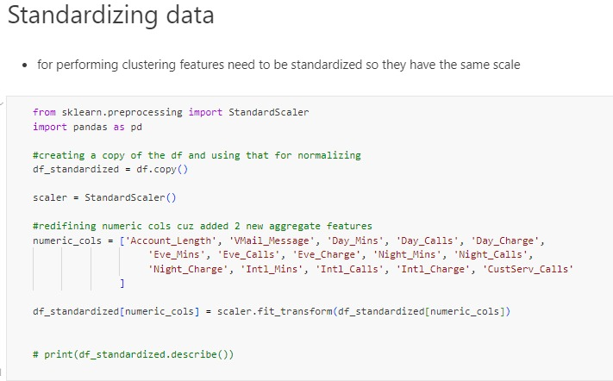

Slide 22
MODULE 03 : DIMENSIONALITY REDUCTION (PCA)
Purpose: Reduces the dimensionality of the dataset to make it more manageable for clustering and visualization, ensuring that only the most significant features are used in the analysis.
PCA (Principal Component Analysis): Reduces the number of dimensions while preserving as much variance as possible.
This step simplifies the data and highlights the most influential features, preparing it for more effective clustering.

Slide 23
MODULE 04 : CLUSTERING ANALYSIS
Purpose: Executes clustering on the dimensionally reduced data to identify natural groupings within the dataset, followed by visualization of the results for interpretability.
K-Means Clustering: Implements the K-Means algorithm on the reduced dataset to partition it into distinct clusters, optimizing for intra-cluster similarity and inter-cluster differentiation.

Slide 24
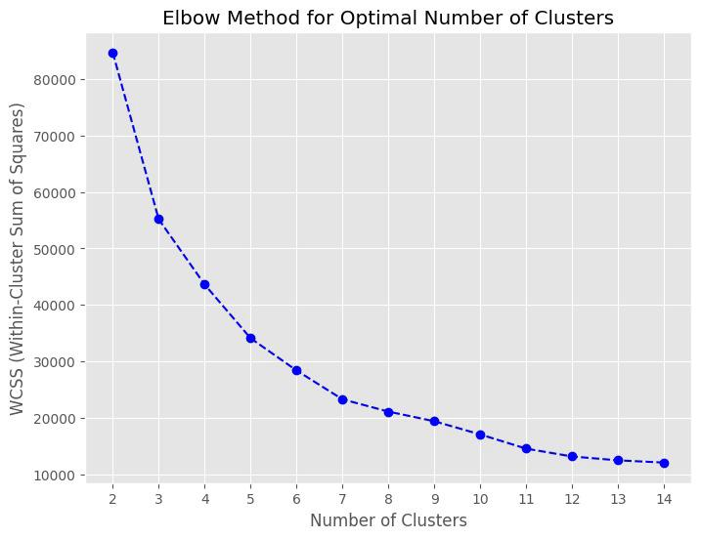

Slide 25
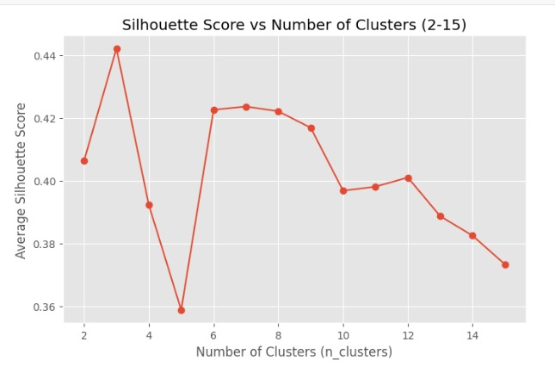
SILHOUETTE SCORE

Slide 26
DIFFERENT APPROACHES
Approaches Evaluated:
1.Dimensionality Reduction Techniques: PCA, t-SNE, UMAP
2. Clustering Algorithms: K-means Clustering ,Hierarchical Clustering.
Key Insights:
After evaluating multiple clustering approaches, PCA with K-Means emerges as the optimal choice due to its simplicity, scalability, and effectiveness in identifying clusters .

Slide 27
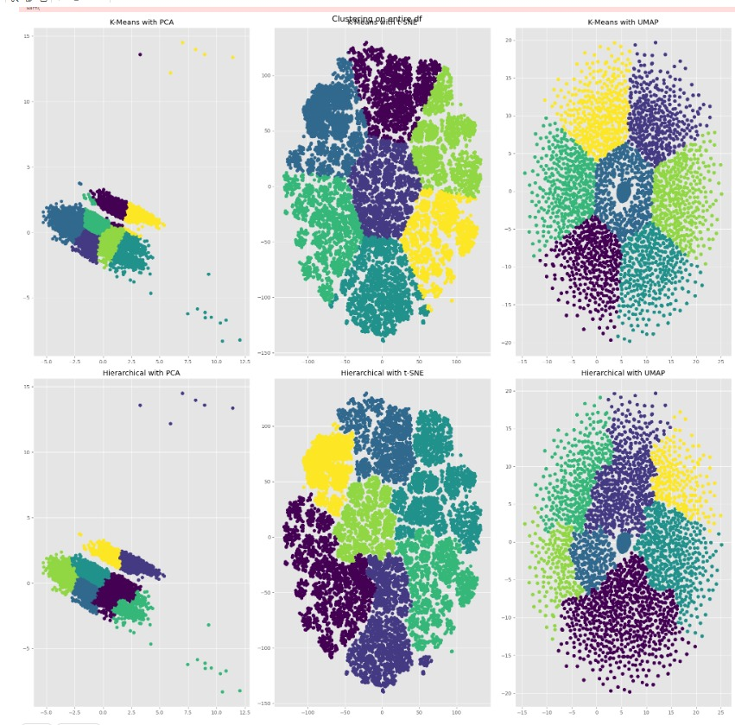
DIFFERENT APPROACHES

Slide 28
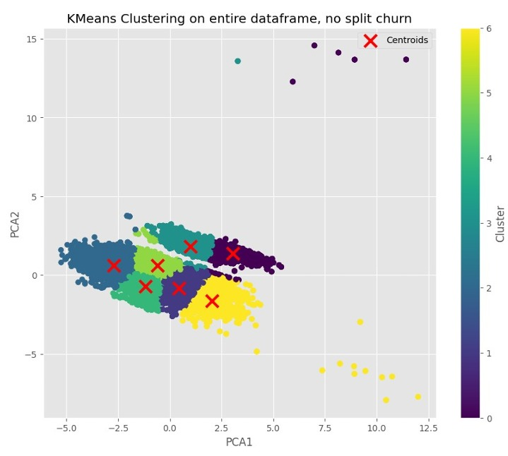

Slide 29
CLUSTERS
0-Premium High Usage Customers
1-Moderate Daytime and Evening Users
2-Economy Users
3- Night-time International Callers
5-Frequent Short International Callers
4-Average Balanced Users
6-Ultra-High Usage Customers

Slide 30
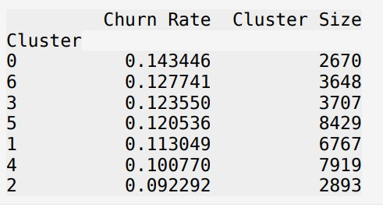
CHURN RATE ANALYSIS FOR CLUSTERS

Slide 31
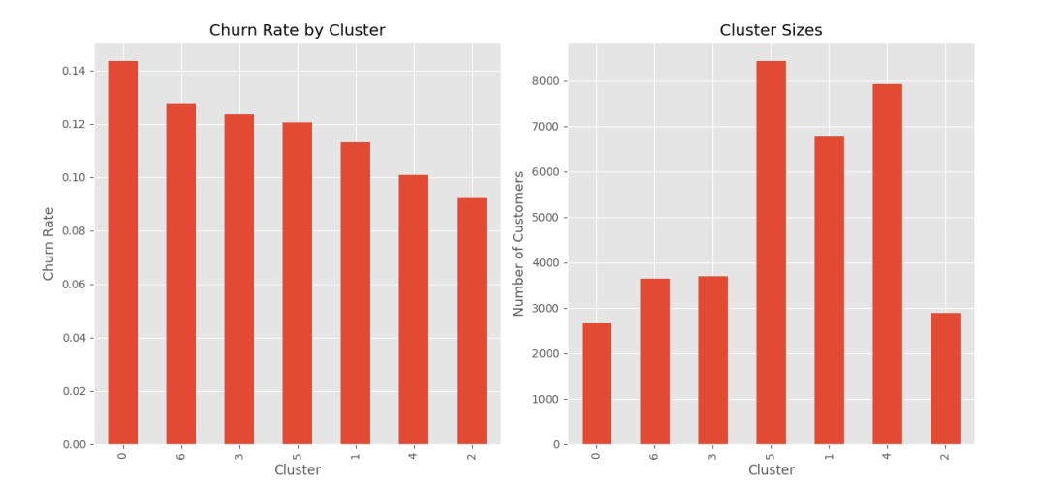

Slide 32
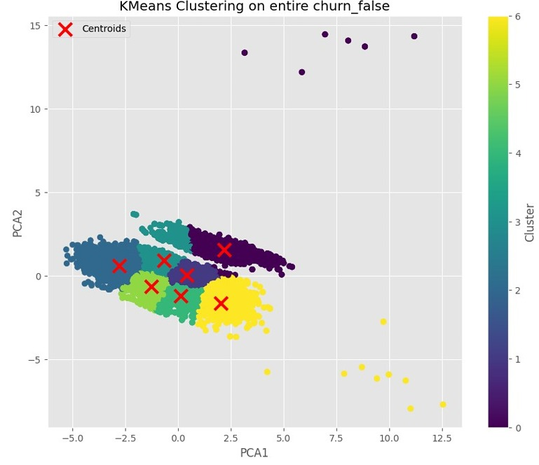

Slide 33
CLUSTERS FOR CHURN FALSE
0- High Usage Premium Customers
1-Moderate Business Users
2-Economy Users
3- Average Users with High International Usage
5-Basic Plan Users
4- Moderate Daytime Users
6-Ultra-High Usage Customers

Slide 34
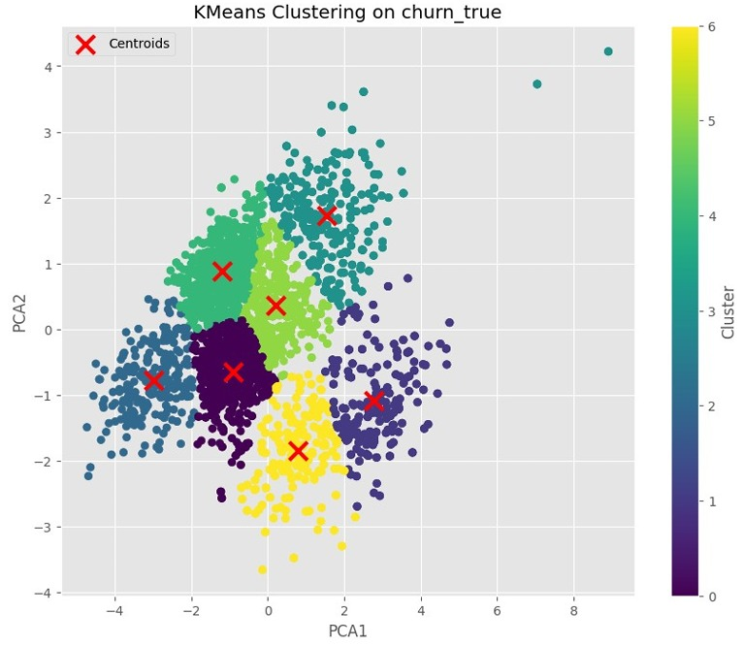

Slide 35
CLUSTERS FOR CHURN TRUE
0-Average Users with Short Calls
1-High Usage Premium Customers
2-Low Usage Economy Users
3- Night-time Heavy Users
5-Daytime Business Users
4-Average Balanced Users
6-Evening and International Callers

Slide 36
MODULE 05 : VISUALIZATION AND REPORTING
Purpose: Generates visual representations of both EDA results and clustering outcomes, providing users with insights through graphical means.
Main Features: EDA visualizations, which includes distribution plots, correlation heatmaps, and outlier detection visuals.
Clustering visualizations, particularly 2D scatter plots illustrating the spatial distribution of identified clusters.

Slide 37
USER INTERFACE (UI)
Purpose: Manages the user interaction layer of the application, implemented through Streamlit, allowing for dynamic exploration of the analysis results.
Sidebar Navigation: A user-friendly interface that enables users to toggle between different sections of the application (EDA and Clustering) through a radio button mechanism.
Interactive Displays: Dynamically updates and displays analysis results based on user selections, providing an engaging and intuitive user experience.

Slide 38
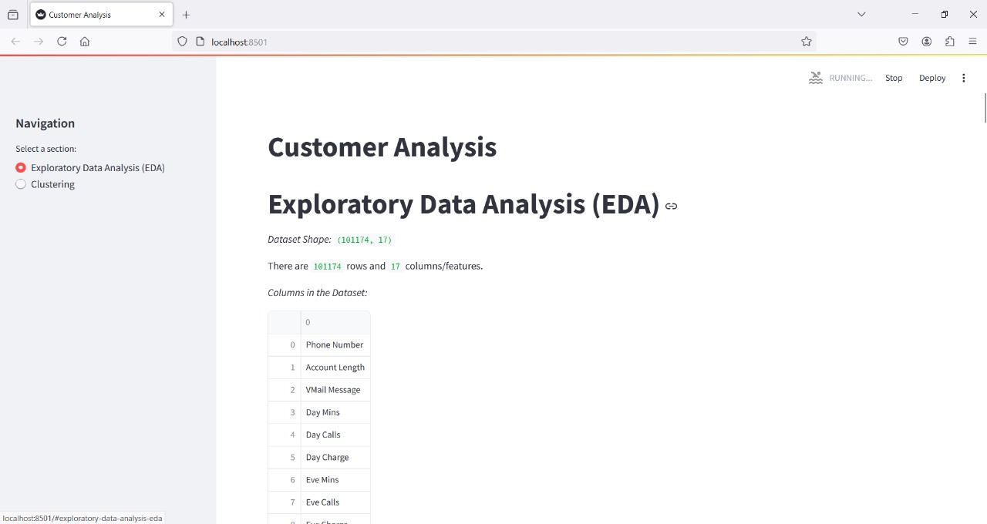

Slide 39
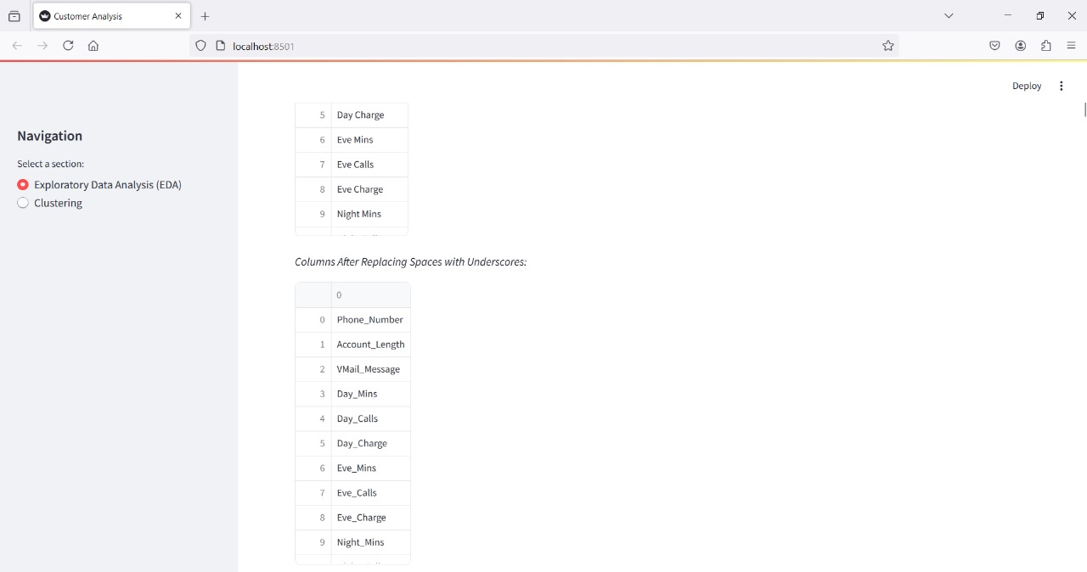

Slide 40
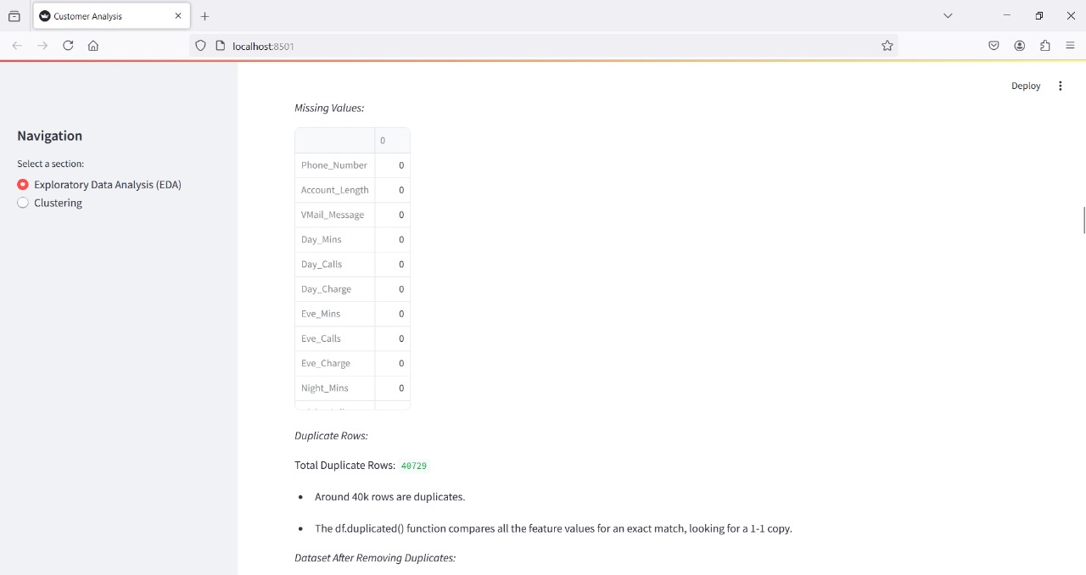

Slide 41
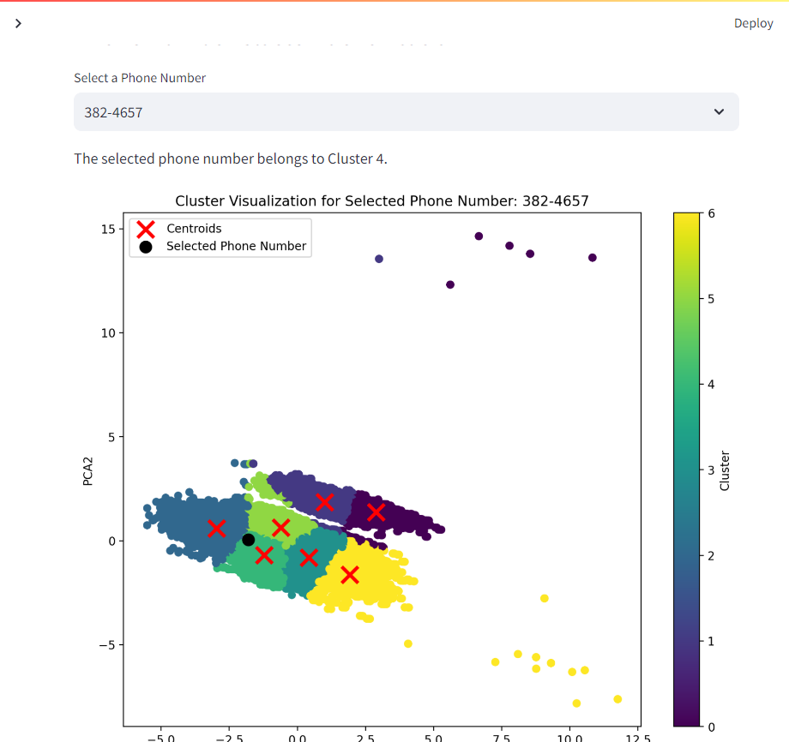
PHONE NUMBER CLUSTER IDENTIFICATION

Slide 42
CONCLUSION
Our project transformed raw data into actionable insights through cleaning, standardization, and PCA-based dimensionality reduction.
We have identified patterns using K-means clustering, validated with elbow and silhouette scores.
Segmenting customers by churn behavior enabled us to assess churn rates and identify high-risk segments for targeted retention.
Visual cluster analysis and an interactive UI via Streamlit facilitate user exploration of insights.
Provides a strategic roadmap for optimizing marketing, boosting retention, and effectively targeting upsell opportunities.

Slide 43
THANK YOU

